Slide 1
UTHSC College of Dentistry HSC Advisory Board Meeting May 20, 2019
James C. Ragain, Jr, DDS, MS, PhD
Dean, UTHSC College of Dentistry

Slide 2
Doctor of Dental Surgery Program, Class of 2023
 | Total Applicants | Male | Female | Hispanic | Am. Indian | Asian | Black/ African Am. | Average GPA | Average DAT
Accepted | 99 ADEA National 2016 | 64 (51.4%) | 35 (48.6%) | 2 (9.1%) | 0 (0.2%) | 16 (24.1%) | 5 (5.0%) | 3.63 (3.5) | 20.6 (19.9)
TN | 158 | 78 | 88 | 8 | 0 | 26 | 17 | 3.42 | 21
AR | 84 | 34 | 39 | 2 | 2 | 7 | 6 | 3.41 | 19
Out of State | 1150 | 546 | 612 | 92 | 13 | 295 | 53 | 3.41 | 19
All Applicants | 1402 | 669 | 732 | 102 | 15 | 328 | 76 | 3.41 | 19

Slide 3
Doctor of Dental Surgery Program, Class of 2023
Accepted State of Residence | Total
AL | 1
AR | 25
CA | 1
GA | 2
KY | 1
MI | 1
TX | 2
UT | 1
TN | 63

Slide 4
Bachelor of Science in Dental Hygiene, Class of 2021
 | Total Applicants | Male | Female | Hispanic | Asian | African American | White | Average Cum. GPA | Average Prereq. GPA
Accepted | 30 | 0 | 30 | 1 | 3 | 3 | 23 | 3.20 | 3.28
TN | 44 | 0 | 44 | 2 | 2 | 10 | 30 | 3.18 | 3.28
Out of State | 20 | 0 | 20 | 0 | 2 | 2 | 16 | 3.20 | 3.29
All | 64 | 0 | 64 | 2 | 4 | 12 | 46 | 3.19 | 3.29

Slide 5
Bachelor of Science in Dental Hygiene, Class of 2021
Accepted State of Residence | Total
AR | 2
MS | 4
OK | 1
TN | 22
VA | 1

Slide 6
Dean’s Objectives 2019-2020
Clinical Excellence in Dental Education.
Talent (Chairs, faculty and students)
Infrastructure and equipment (Dunn Dental Building and
Delta Dental of Tennessee Building)
Scholarly Activity
Stabilize CoD Leadership. Searches underway for:
Chair of the Department of Oral Maxillofacial Surgery
Chair of the Department of Prosthodontics
Chair of the Department of Periodontics
Hire a Federally Funded Basic Science/Translational
Science Researcher.

Slide 7
Dean’s Objectives 2019-2020
Continue Alumni Engagement in CoD Activities.
Explore adding D4 Clinic Rotations in Knoxville, Nashville,
and Arkansas (two locations).
Standup New Department “The Department of Community Health.”
Community oral /systemic health.
Social determinants of health.
Pediatric Dentistry outreach
Geriatric Dentistry outreach
Special Needs Patients Program (Preparation for Special Needs Clinic in
the new Delta Dental of Tennessee Building)

Slide 8
Dean’s Objectives 2019-2020
Determine the Feasibility of Establishing a BSDH Program
on the Knoxville campus.
Enroll a class in the CoD Memphis AEGD Program for 2020-2021.
Determine the Feasibility of Establishing a CoD General Practice
Residency Program in Memphis.

Slide 9
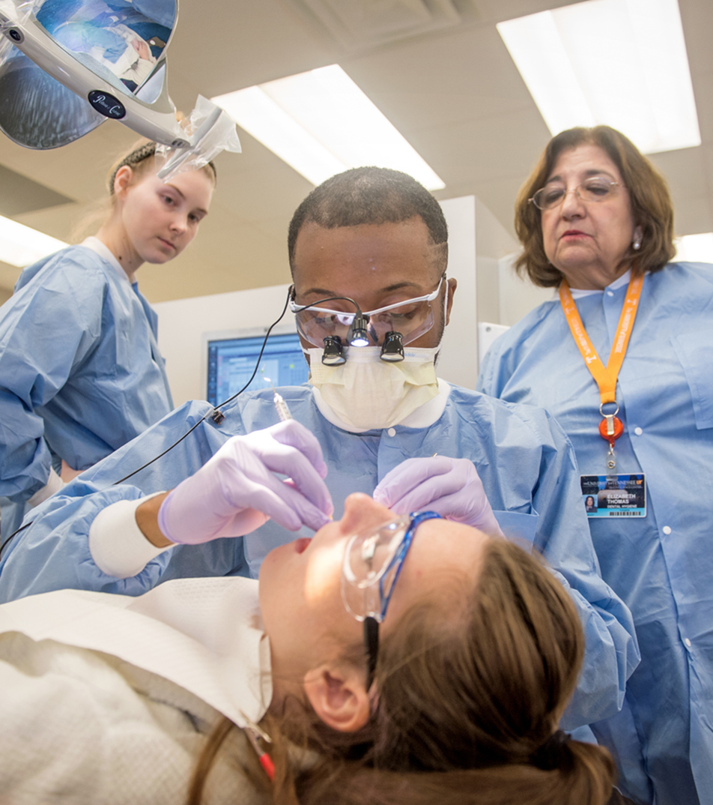
Questions?

